Slide 1


Phishing Awareness Training
This training will provide you with the knowledge and tools to identify and avoid phishing attacks, protecting yourself and your organization from cyber threats.
by ADITYA SALUNKE

Slide 2
What is Phishing?
Phishing is a type of cyberattack where criminals use deceptive tactics to trick you into giving them your personal information, such as passwords, credit card details, or sensitive data. They often do this through emails, websites, or social media messages that look legitimate but are actually designed to steal your information.
Phishing attacks are becoming increasingly sophisticated, making it harder to spot them. But with some basic knowledge, you can learn how to identify and avoid them. This presentation will equip you with the tools and knowledge to protect yourself from these attacks.

Slide 3
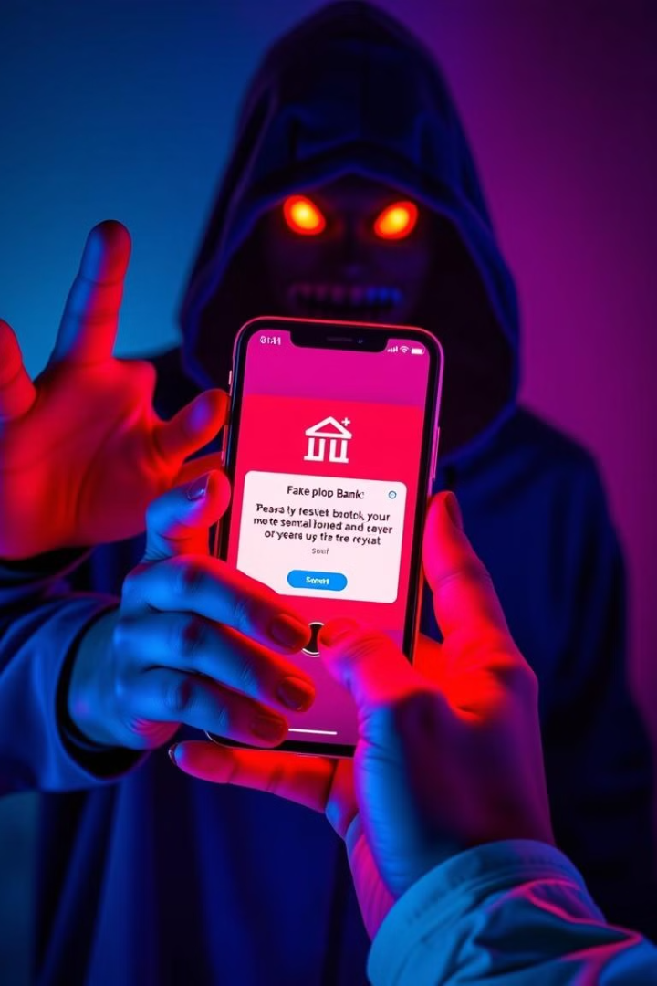
How Phishing Attacks Work
1
Phishing attacks typically start with an email, website, or social media message that appears legitimate. It might be from a trusted source, such as a bank, a government agency, or a social media platform.
2
The message will contain a link or an attachment that leads to a fake website or download. This website or attachment will look similar to the legitimate one, but it's actually designed to steal your information.
3
Once you click on the link or download the attachment, your computer or mobile device could be infected with malware or you might be tricked into providing your personal information to the attacker.

Slide 4
Types of Phishing Attacks
Email Phishing
Website Phishing
The most common type of phishing attack, where attackers send emails that appear to be from legitimate sources, requesting sensitive information or asking you to click on a malicious link.
This involves creating fake websites that mimic legitimate ones, often targeting users searching for specific products or services online. These websites are designed to steal login credentials or credit card details.
Smishing
Vishing
This type of phishing attack uses SMS messages to trick users into giving away personal information. The messages may appear to be from a bank, a shipping company, or a social media platform.
This attack uses phone calls to trick users into revealing sensitive information. Attackers may impersonate bank employees, government officials, or other trusted individuals.

Slide 5
Signs of a Phishing Attack
Suspicious Sender
Urgent Requests
Check the sender's email address. Does it look legitimate, or does it have misspellings or odd characters? If the email address doesn't match the sender's name, it could be a phishing attack.
Be cautious of emails that demand immediate action, such as clicking on a link or downloading an attachment. Legitimate organizations rarely use this kind of language. They often include a link to a website or email address. Check the link.
Grammatical Errors
Suspicious Links
Phishing emails often contain spelling or grammar errors, as they are typically written by non-native English speakers. If you spot any errors, be suspicious.
Hover over any links before clicking on them. Check the URL in the status bar. If it doesn't match the sender's website, it's likely a phishing attack.

Slide 6




Protecting Yourself from Phishing Attacks
Strong Passwords
Be Vigilant
Double-Check
Use Security Software
Use strong passwords and change them regularly. A strong password is at least 12 characters long and includes a mix of uppercase and lowercase letters, numbers, and symbols. Also, don't use the same password for multiple accounts. Use a password manager to store your passwords securely.
Be careful about the emails, websites, and social media messages you interact with. If something seems suspicious, don't click on links or download attachments. Report any suspicious activity to your IT department or the appropriate authorities.
Always double-check with the organization if you receive a suspicious email. Look for their official website or call their customer service number to verify the request. Don't rely solely on the information in the email.
Install and keep your security software up to date. Antivirus software and anti-malware programs can help protect your computer from malware and other threats. Also, ensure your operating system and software are patched with the latest security updates.

Slide 7




Examples of Phishing Attacks
Fake Bank Emails
Attackers might send emails claiming to be from your bank, asking you to update your account information or verify your login details. They might also send emails that appear to be from a shipping company, asking you to verify your delivery address or pay for shipping fees.
Fake Invoice Emails
Attackers often send fake invoice emails that appear to be from a legitimate business, requesting payment for goods or services you didn't order. The emails might include a link to a fake website to make the request appear genuine.
Social Media Impersonation
Attackers may create fake social media profiles that mimic legitimate individuals or organizations. They might then send messages to their followers, asking them to click on a link or download an attachment that contains malware.
Phishing through SMS
Attackers can send SMS messages that appear to be from a bank, a shipping company, or a social media platform, asking you to click on a link to verify your account information or update your payment details.

Slide 8





Social Engineering Tactics
Pretexting
1
Attackers use this tactic to create a believable story or scenario to gain your trust and obtain sensitive information.
Baiting
2
Attackers offer something tempting, like free gifts, discounts, or access to exclusive content, to lure victims into a trap.
Scare Tactics
3
Attackers create a sense of urgency or fear to pressure victims into making hasty decisions and giving away sensitive information.
Phishing
4
The most common tactic, where attackers use deceptive emails, websites, or social media messages to trick victims into giving away sensitive information.
Impersonation
5
Attackers try to impersonate a trusted individual or organization, often using stolen identities or fake accounts to deceive victims.

Slide 9
Reporting Phishing Attacks
Forward Suspicious Emails
1
If you receive a suspicious email, forward it to your IT department or the appropriate authorities. Do not click on any links or attachments in the email.
Report Phishing Websites
2
If you encounter a phishing website, report it to the website owner or to the appropriate authorities. You can also report it to organizations that track phishing websites, such as the Anti-Phishing Working Group (APWG).
Report Social Media Phishing
3
If you encounter a phishing attempt on social media, report it to the social media platform. You can also report it to the appropriate authorities.

Slide 10

Conclusion
1
2
Be Vigilant
Report Suspicious Activity
Always be aware of your surroundings and the information you share online. If something seems suspicious, don't click on links or download attachments.
Report any suspicious activity to your IT department or the appropriate authorities. Your actions can help protect others from falling victim to phishing attacks.
3
Stay Informed
Stay up to date on the latest phishing scams and security threats. By learning about the different tactics attackers use, you can better protect yourself.

